Slide 1
Introduction to Bioinformatics
In the name of the most high
Genotyping
Ali Sharifi-Zarchi
Department of Computer Engineering, Sharif University of Technology
These slides are available under the Creative Commons Attribution License.

Slide 2
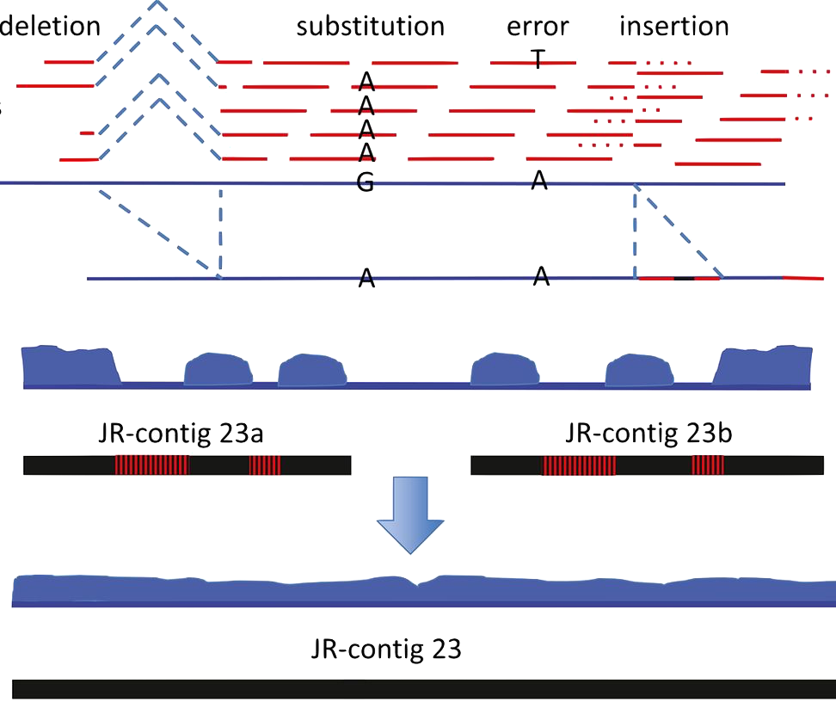
Variant Calling
http://www.genetics.org

Slide 3
GATK

Slide 4
Classification
Gene B
Gene A

Slide 5
Neural Networks
5
1
3
2
13
1
2

Slide 6
Deep Neural Networks

Slide 7
Inception

Slide 8
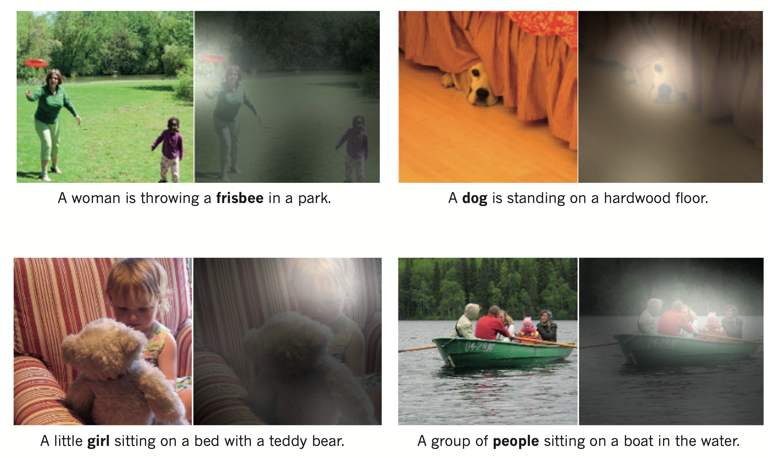
From Image to Text
LeCun, Y., et al. Nature (2015)

Slide 9
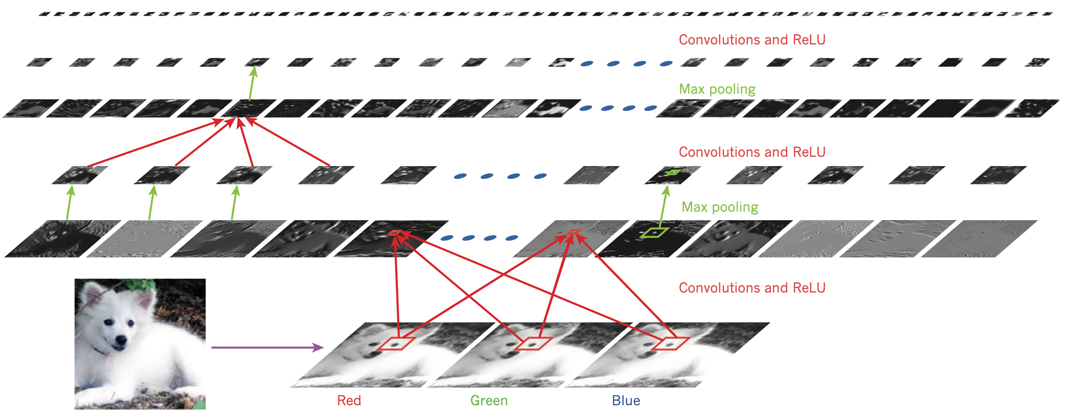
Features
LeCun, Y., et al. Nature (2015)

Slide 10
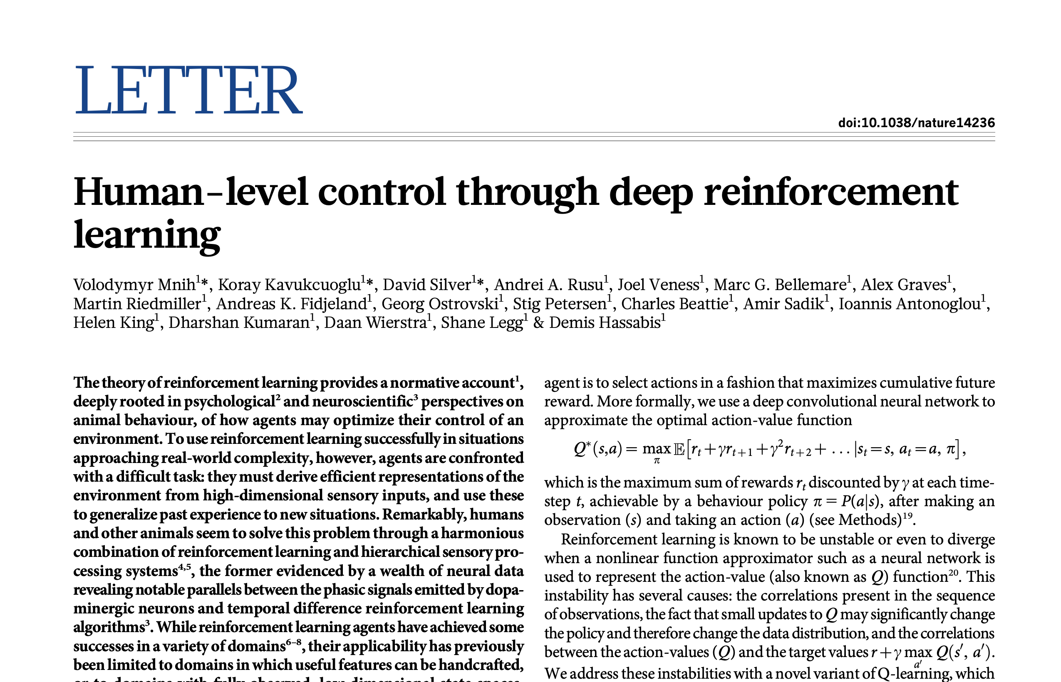
Even Games!

Slide 11
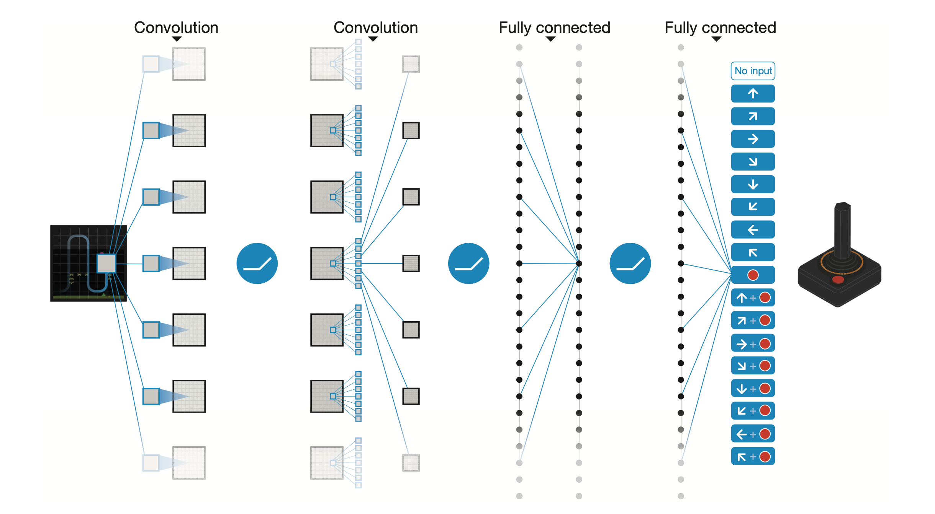
Even Games!

Slide 12
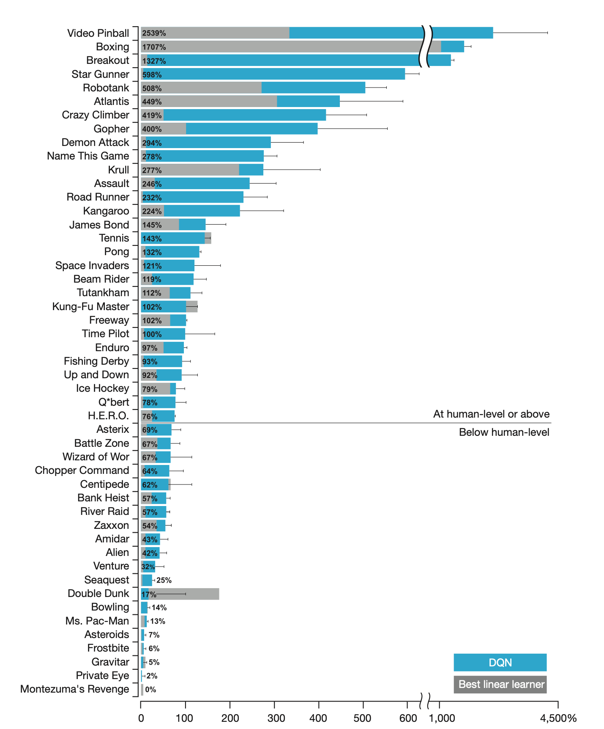
Even Games!

Slide 13

Even Games!

Slide 14
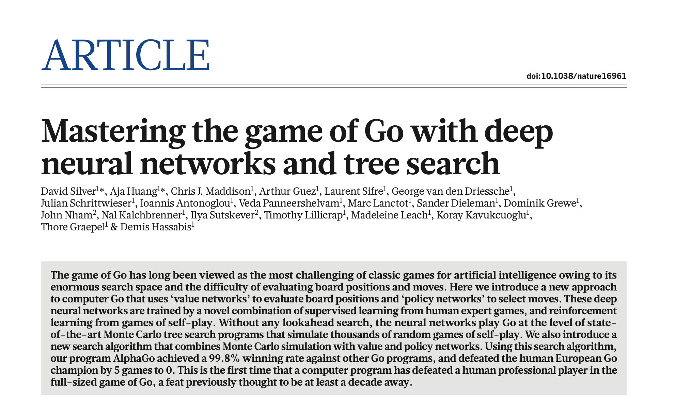
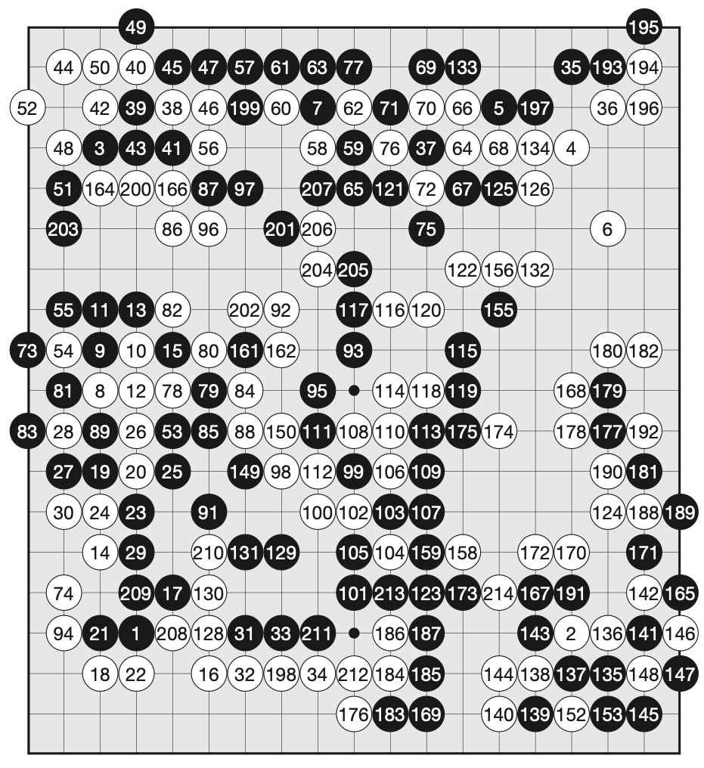
GO

Slide 15
Autoencoders

Slide 16
Autoencoders
http://kvfrans.com/variational-autoencoders-explained/

Slide 17

Denoising Autoencoders
http://kvfrans.com/variational-autoencoders-explained/

Slide 18
Variational Autoencoders
http://kvfrans.com/variational-autoencoders-explained/

Slide 19
Variational Autoencoders
http://kvfrans.com/variational-autoencoders-explained/

Slide 20
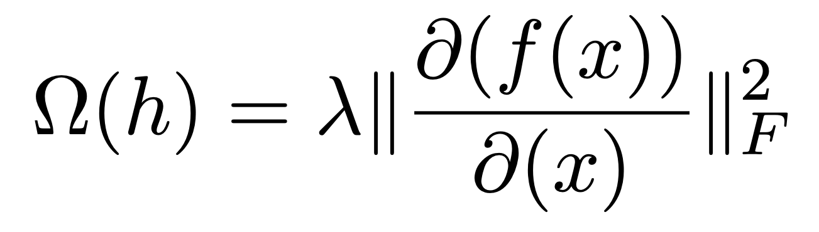
Contractive Autoencoders
http://kvfrans.com/variational-autoencoders-explained/

Slide 21
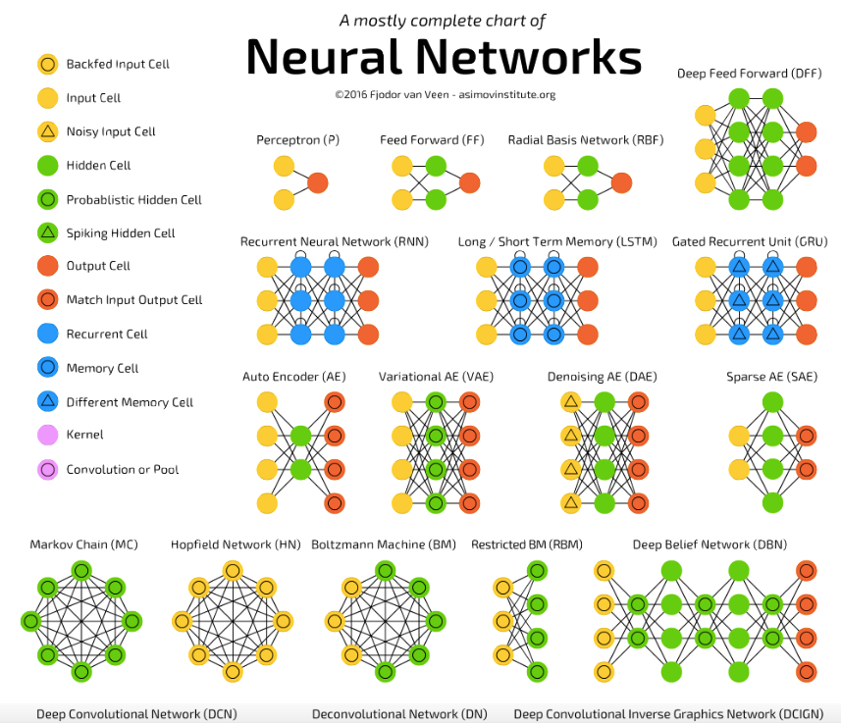
THE NEURAL NETWORK ZOO

Slide 22
Variational Autoencoders
https://jaan.io/what-is-variational-autoencoder-vae-tutorial/

Slide 23
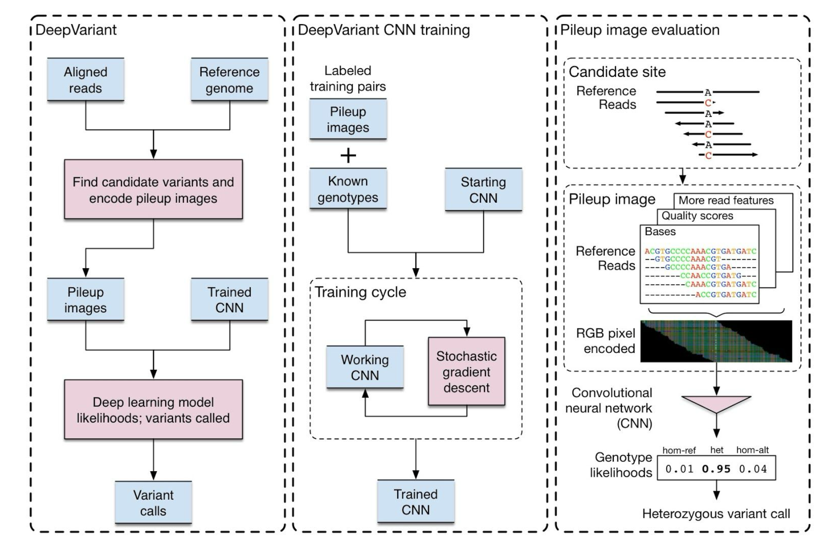
DeepVariant
Poplin R. et.al., 2016

Slide 24
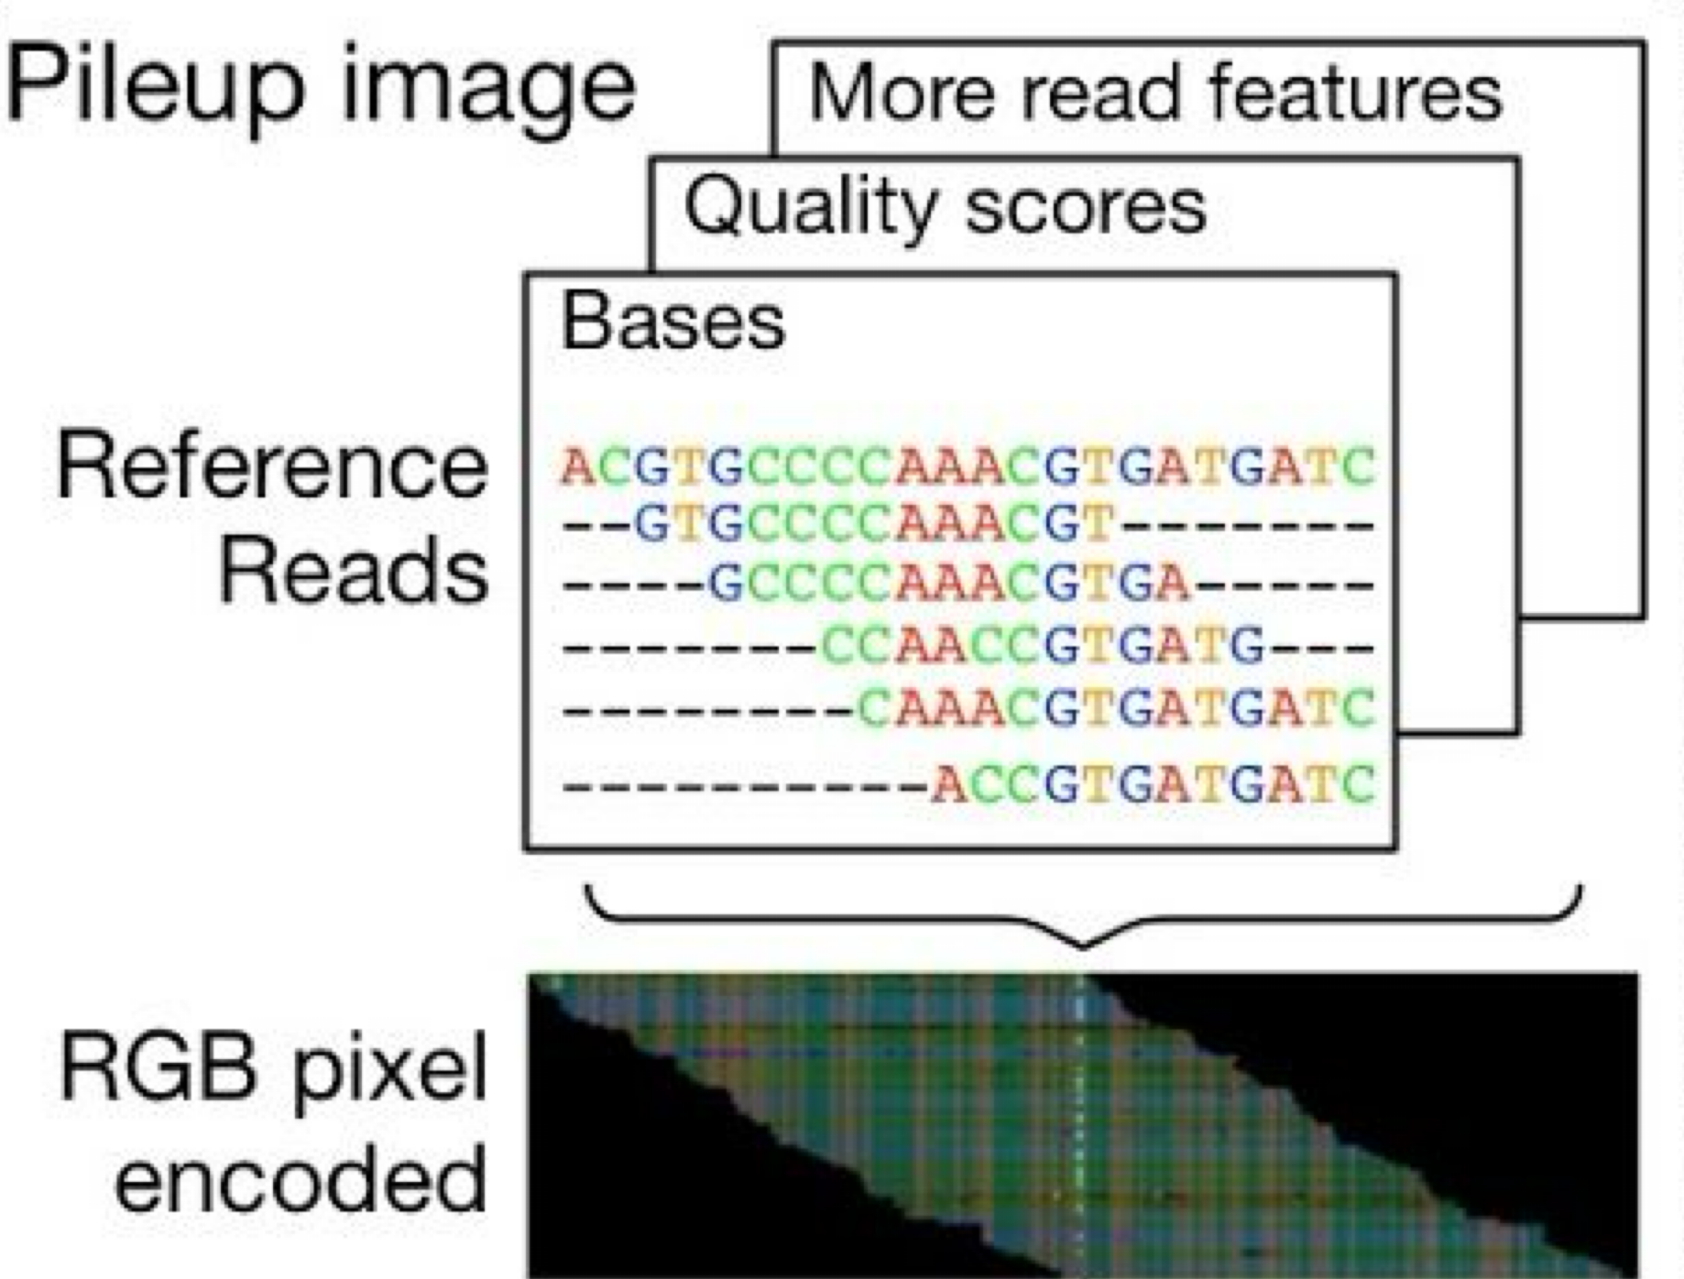
DeepVariant
Poplin R. et.al., 2016

Slide 25
Analysis Pipeline
Sample Preparation
Sequencing
Quality Control
Reference Genome Available?
Yes
No
Alignment
Assembly
Variation Detection
Peak Finding
Expression Analysis
Gap Filling
SNV, CNV, Indelds
TFBS,
Histone Codes
Expression Level DE Genes
Reference Genome

Slide 26
Analysis Pipeline
BWA, Bowtie2
Alignment
SAM, BAM
GATK, SamTools
Variation Calling
VCF
ANNOVAR, SIFT, MutationTaster
Variation Annotation
Annotated VCF
VCF.Filter, BrowseVCF,
VCF-Miner,
Variation Filtering
Candidate Variations

Slide 27
VCF File Structure
https://www.dnastar.com/

Slide 28
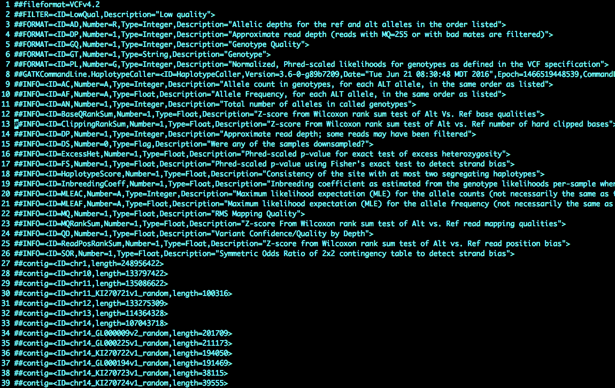
VCF File Structure

Slide 29
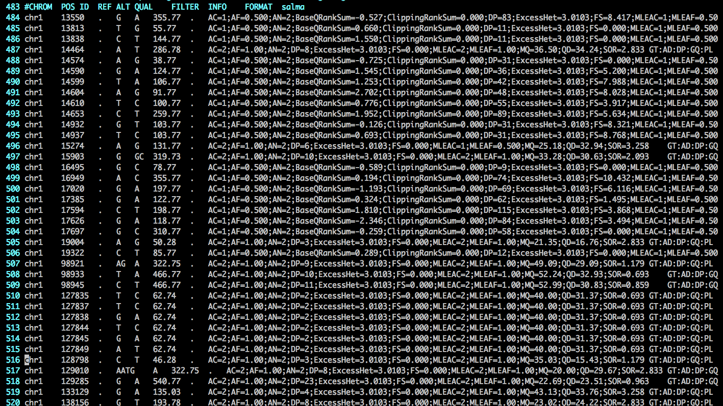
VCF File Structure

Slide 30
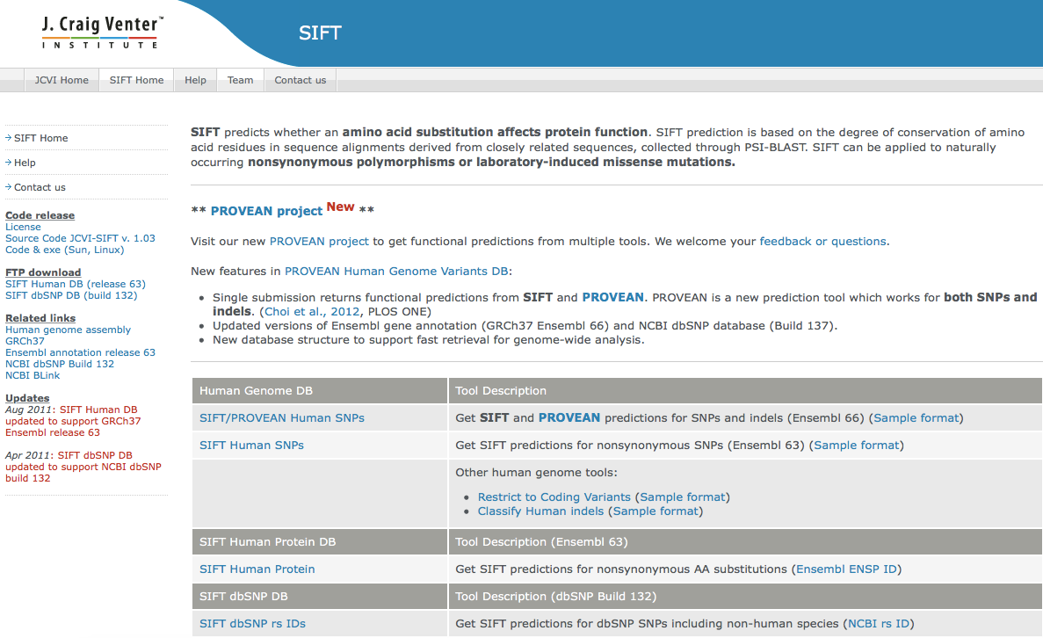
SIFT

Slide 31
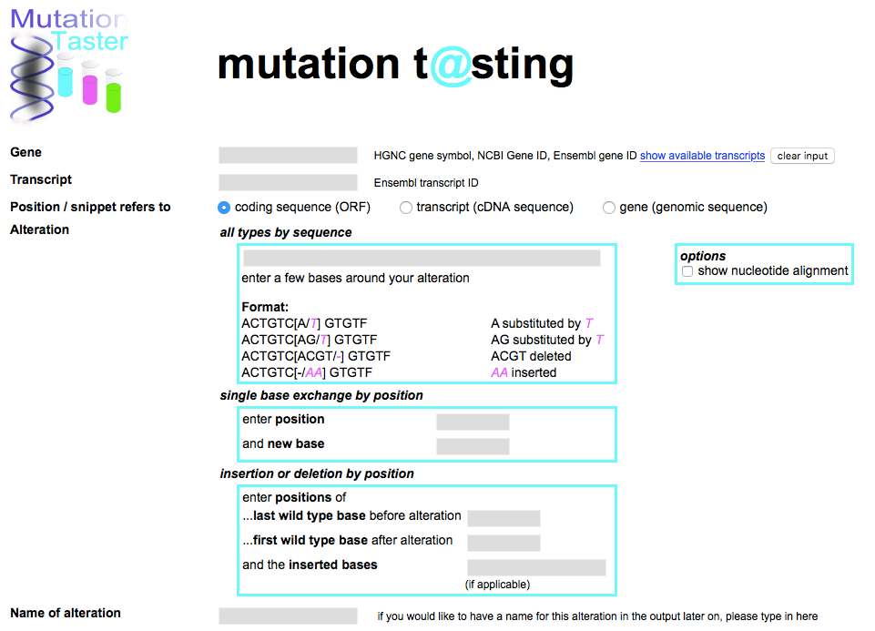
MutationTaster

Slide 32
ANNOVAR

Slide 33
Real Case: Child

Slide 34
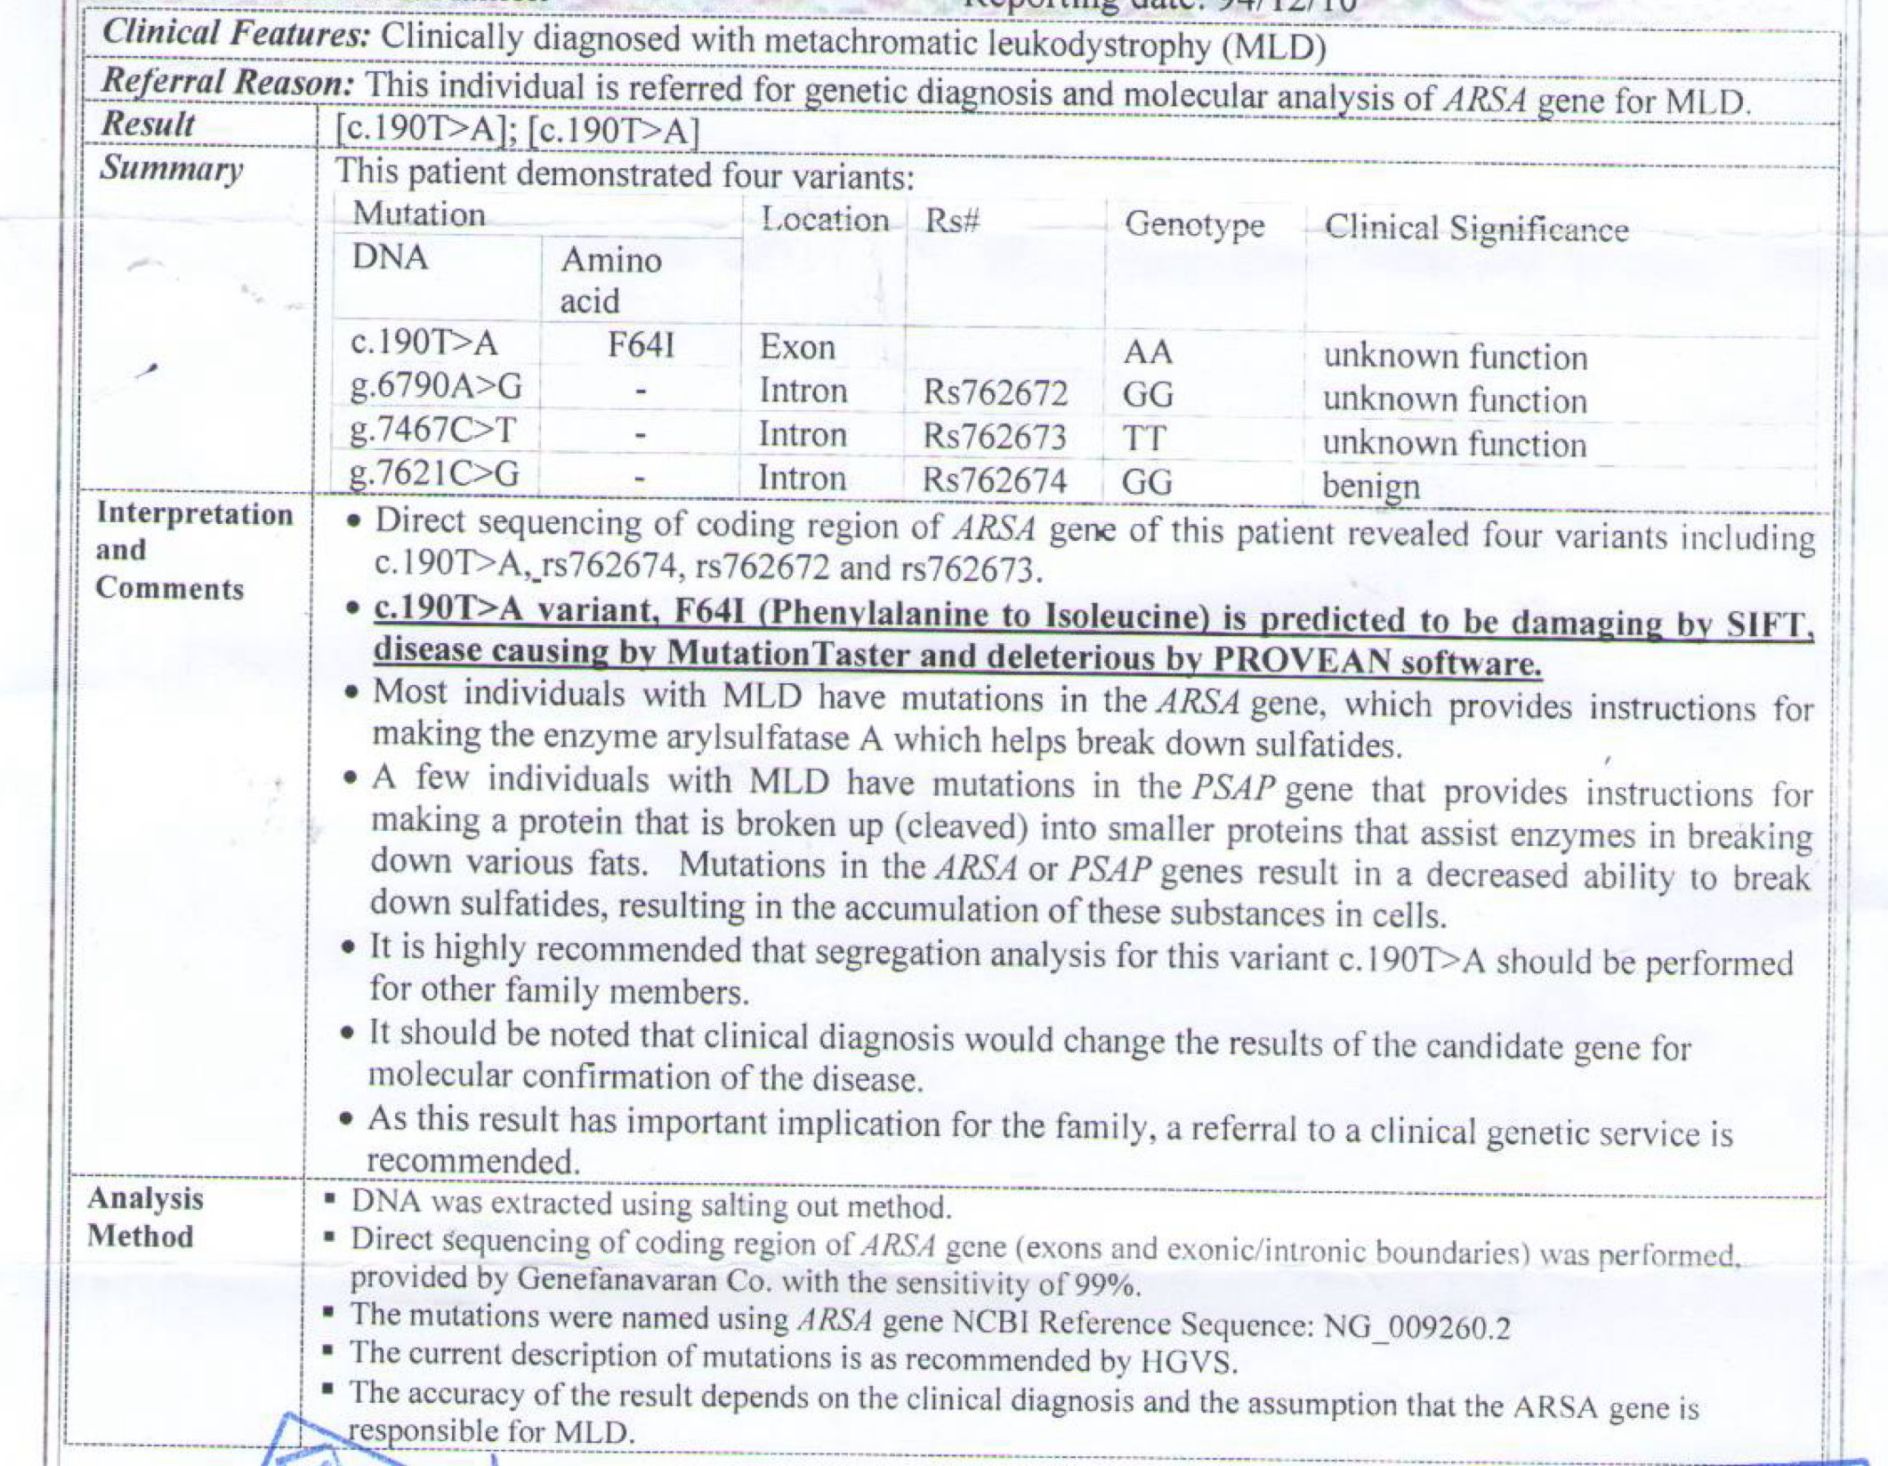
Real Case: Child

Slide 35
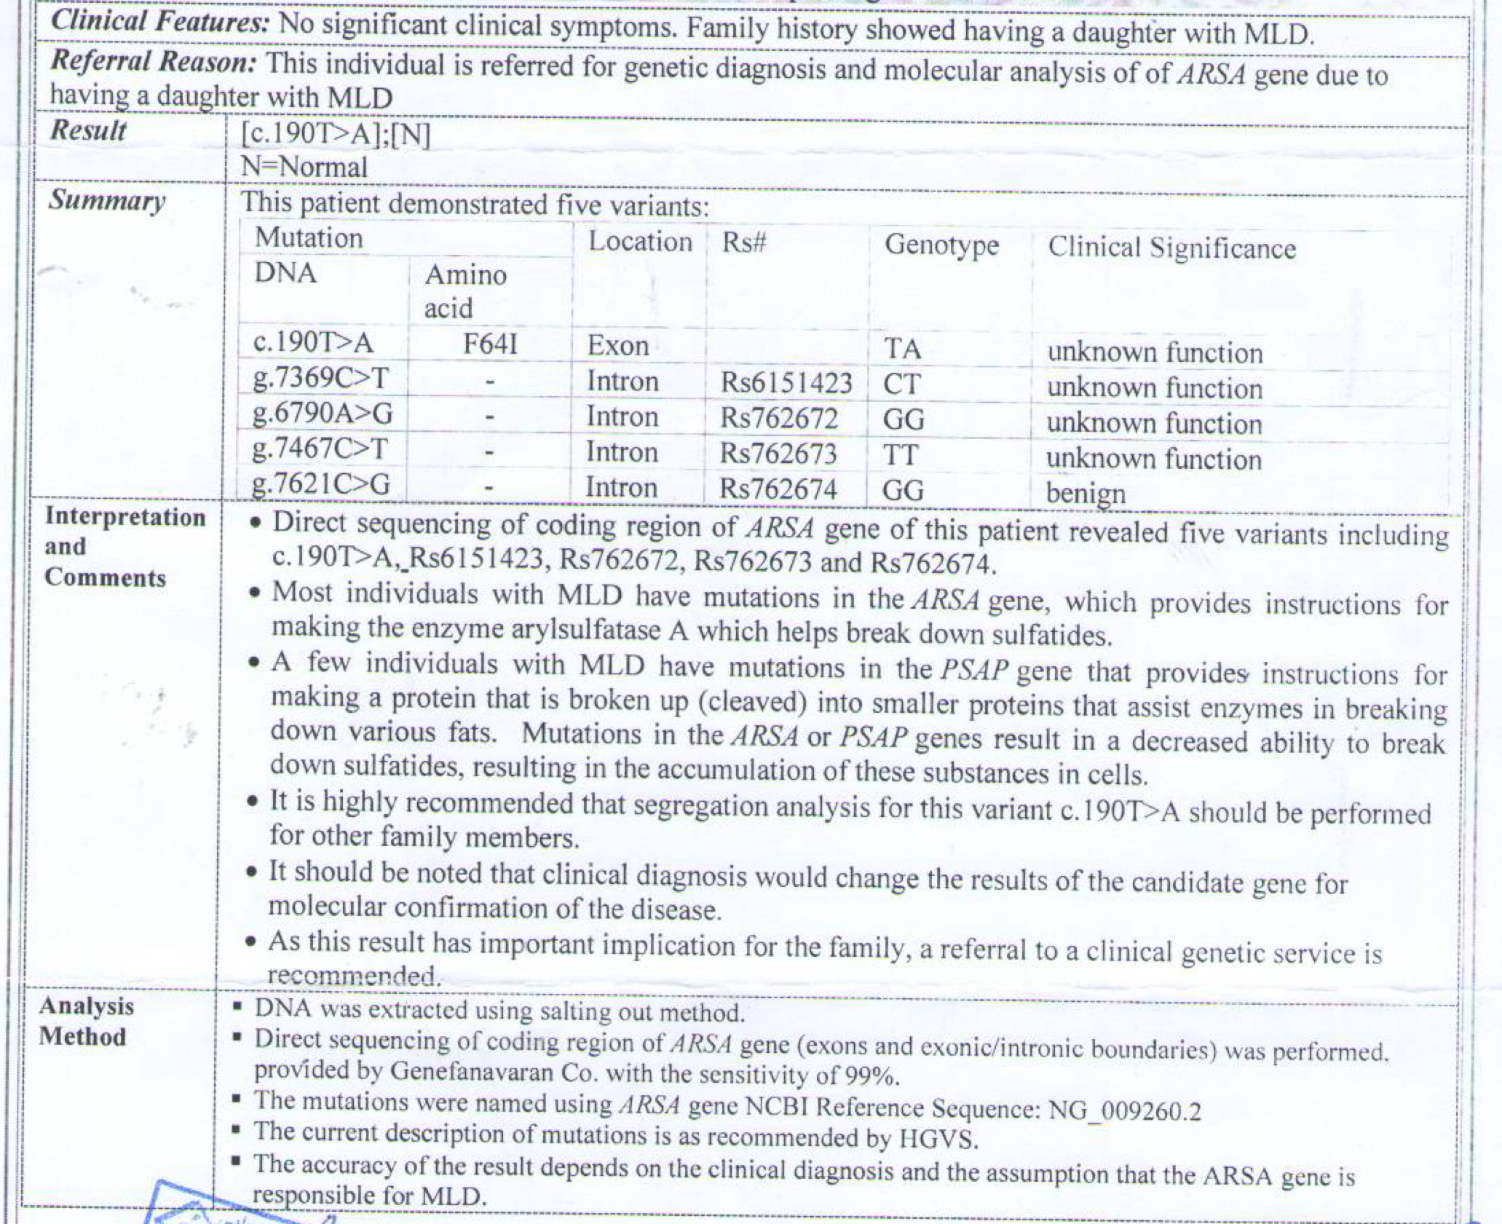
Real Case: Father

Slide 36
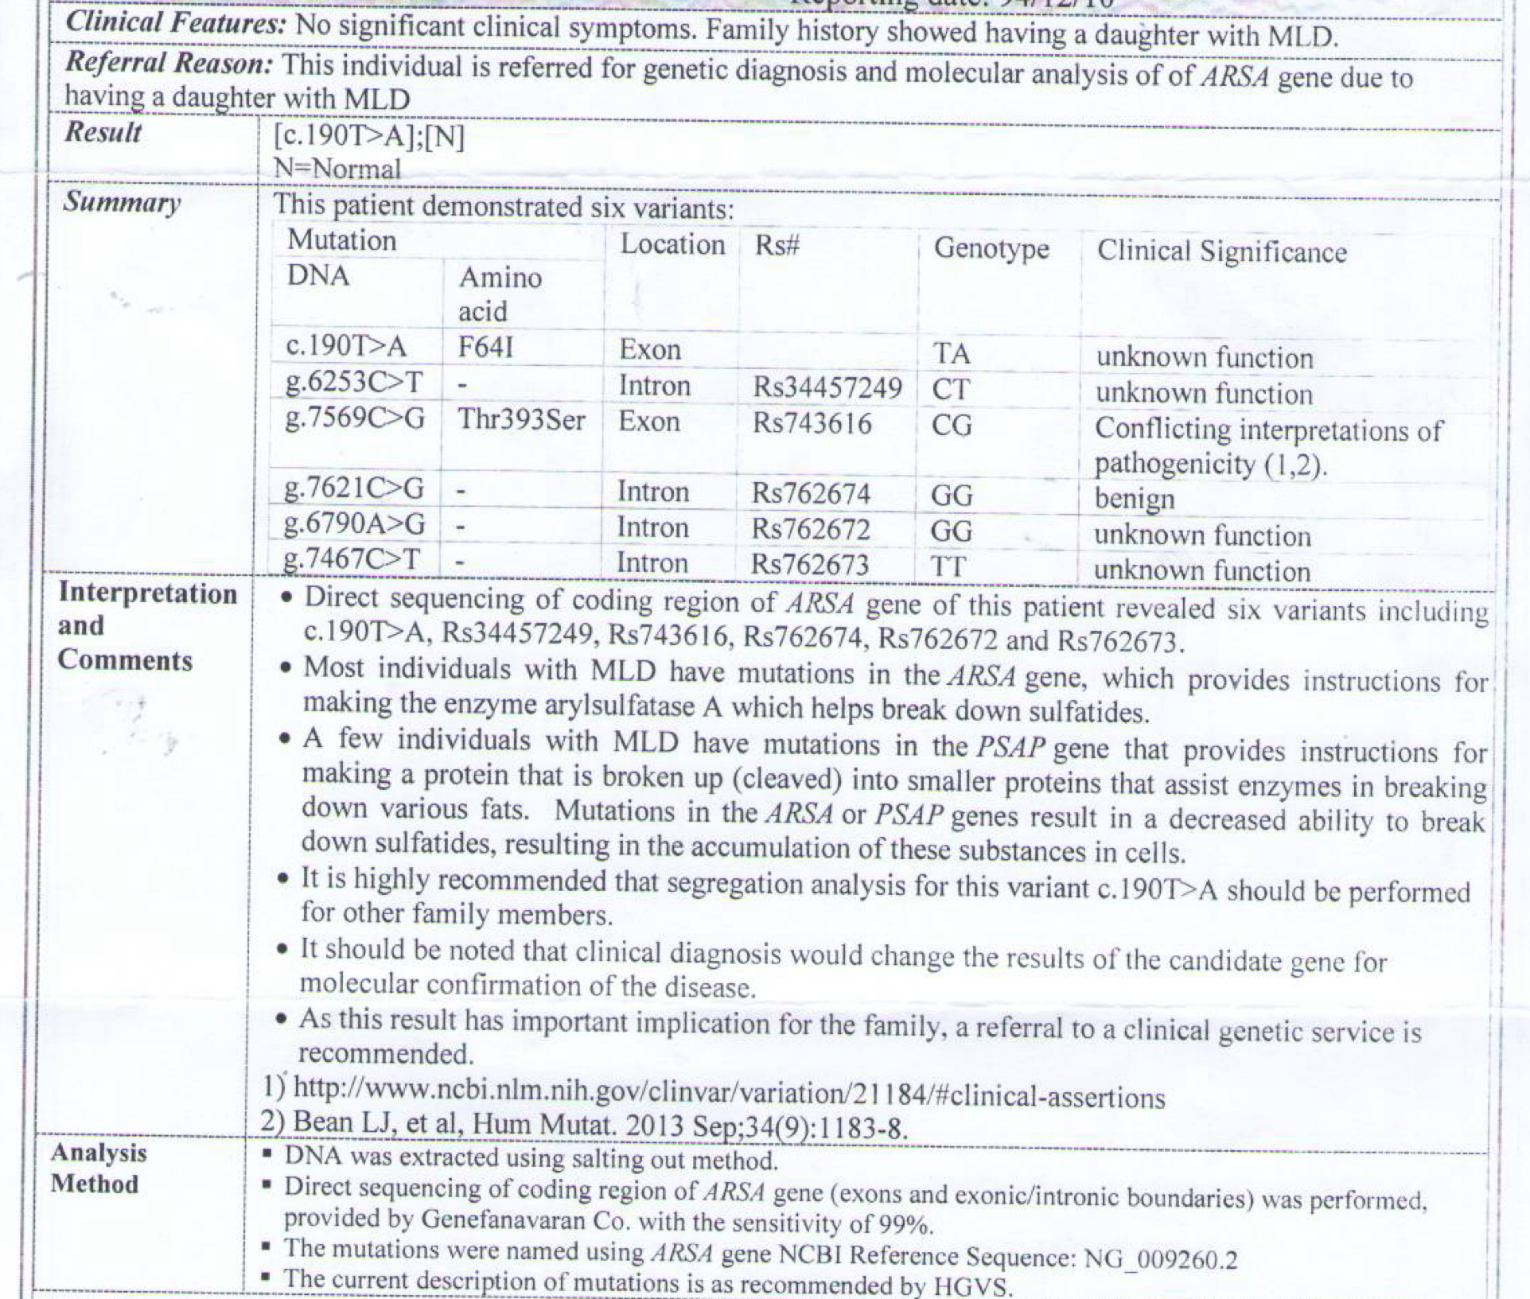
Real Case: Mother

